Slide 1
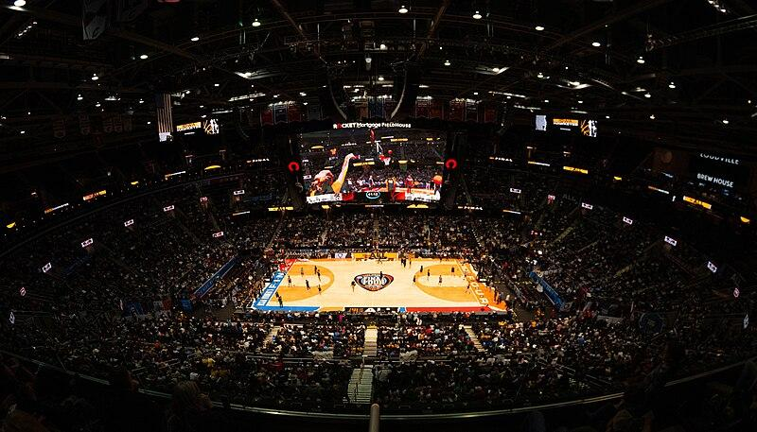
Predicting the
March Madness Champion
Machine Learning Models for Tournament Success
Presented by: Thomas Gauerke, Richie Varos, & John Parente

Slide 2

What is ?
NCAA March Madness is a single-elimination college basketball tournament held annually in March.
Organized by the NCAA, it determines the division 1 national champion of men's and women's college basketball.
The tournament features 68 men's teams and 64 women's teams, competing in a bracket-style format across multiple rounds.
March Madness is known for its unpredictability, thrilling upsets, and intense competition, captivating millions of fans worldwide.
The tournament culminates in the Final Four, where the remaining four teams compete for the championship title.

Slide 3
Project Objectives / Process
Objective: Use historical data to predict the winner of the NCAA March Madness Tournament
Process:
Source Data
Preprocessing / Data Cleaning
Fit data to model
Analyze results

Slide 4
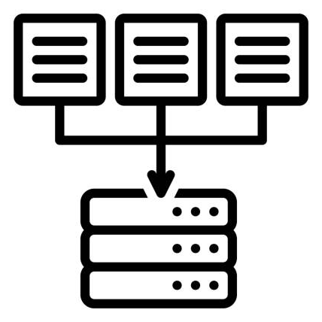
Data Sourcing / Data Cleaning
Source: Kaggle - March Madness Data
Pulled multiple data sets to increase potential features that could determine the target metric (“CHAMP”)
Merged data containing information on teams such as conference, results, upsets, etc.
Cleaned data
Encoded data with dummy values

Slide 5
Data Processing and Compiling
Ratings: Power Ratings for every tournament team since 2016 from ABC News.
Team Resumes: Statistics for every team's resumes since 2008 from Bart Torvik. The ranks of every statistic are ranked out of all Division I College Basketball Teams.
Tournament Matchups: The matchups and final score of each team in the tournament. Each matchup is every two rows.
Team Results: How well each team has performed in the tournament since 2008.
Heat Check: Statistics for every tournament team since 2013 from Heat Check CBB.
Upset Seed: The seed information of each upset. An upset is defined as Team A beating Team B with Team A's seed being 2 or more seeds lower than Team B. For example, a 7 seed beating a 5 seed is an upset and a 9 seed beating and 8 seed is not an upset.
Upset Count: The upset count per year and round since 2008.

Slide 6
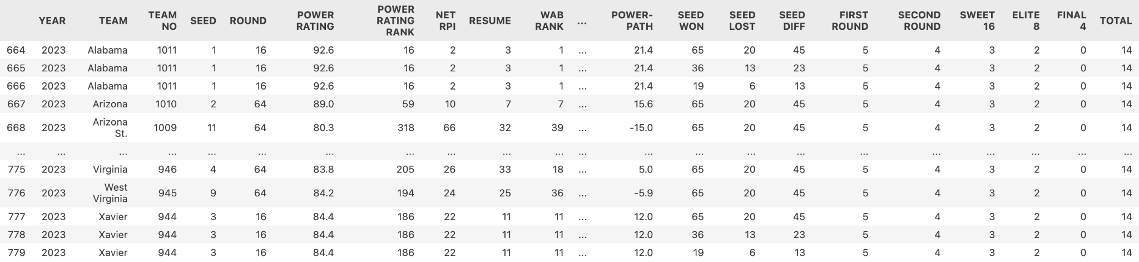
Example of Final Data

Slide 7
Fitting to Model
Split data into features and target
Scale the data
Fit into Keras Sequential Model
Create new method with hyperparameters
Uncover optimal parameters
Apply optimal parameters and train it on the data

Slide 8
Outcome
Challenges: Encountered a mismatch in the number of features between the trained model and the 2024 input data, leading to an unexpected result in predicting the winner for 2024.
Insights: The preprocessing steps applied to the training data and X_2024 might not be the same, or X_2024 might be missing some features present in the training data.
Next Steps: To improve predictive performance, ensure that the input data for prediction matches the structure of the training data, including applying the same preprocessing steps and ensuring the same number of features.

Slide 9
Opportunities to Improve
Data Consistency: Ensure the new data matches the structure of the training data in terms of preprocessing and feature count.
Model Complexity: Experiment with different model architectures and hyperparameters.
Validation Strategy: Use cross-validation for a robust performance estimate.
Feature Selection: Re-evaluate the importance of features used by the model.
Ensemble Methods: Consider combining multiple models for better performance.
Dynamic Input: Allow user of model to input bracket and allow it to make winner prediction

Slide 10
Sources
March Madness Data. Retrieved from Kaggle: https://www.kaggle.com/datasets/nishaanamin/march-madness-data?select=Upset+Count.csv”
Assisted by: GitHub Copilot and OpenAI’s ChatGPT

